Slide 1


In The Name Of ALLAH
Ahmed Khalil Abd El-Hafiz
Sec : “ 1”
Http://www.github/AhmedKhalil777
UI and UX Comparisons for many situations
Reference :https://www.mockplus.com

Slide 2
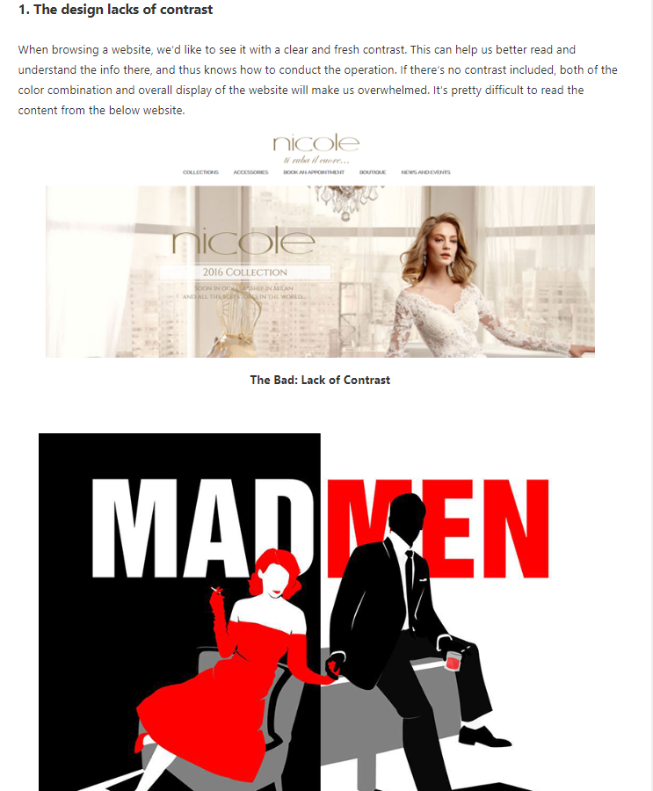
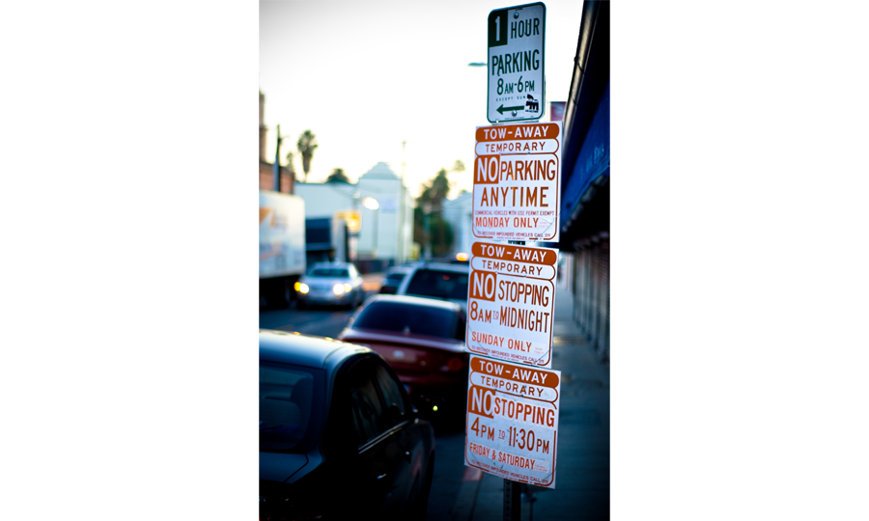
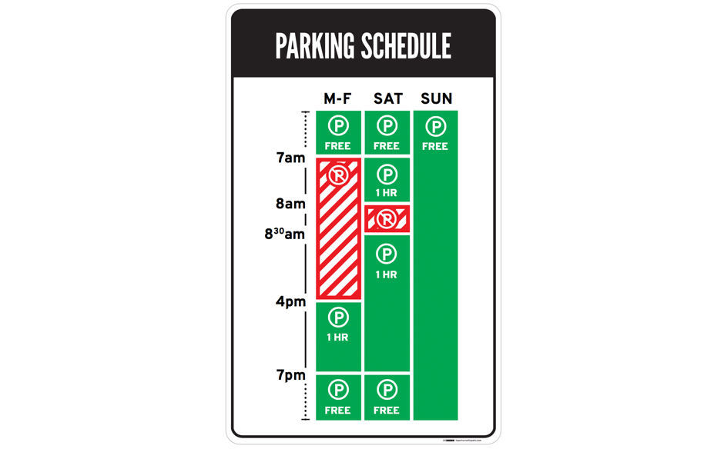
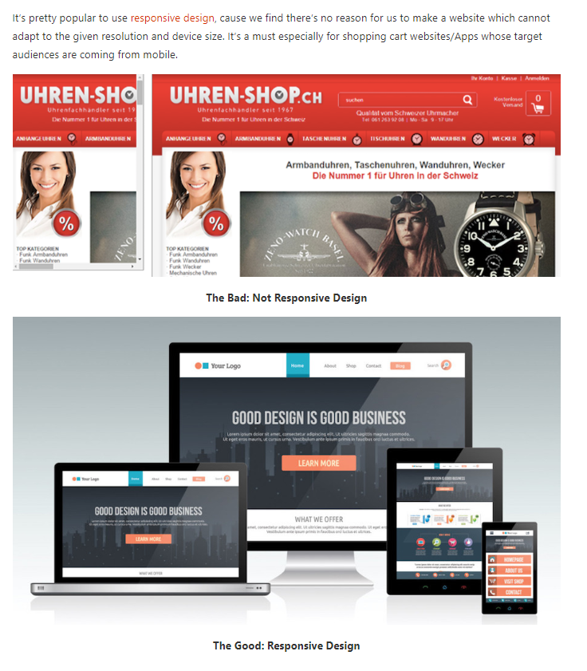
UI and UX Comparisons for many situations
Differences Between Good and Bad Interface Design
There are not a few UI design principles on the web, but the top golden rules for UI design will be the 4E’ in the following. Also, this can be the standard to judge whether it’s a good UI design:
- Error-free.
- Easy to use.
- Easy to understand.
- Effective for the end goal or product.
The bad parking signs in
Los Angeles
Information Overload
Parking signs in LA have been the epitome of information overload for decades
How to Avoid the Most Common Errors of UI Designers?
In general, there are 5 common problems that UI designers make:
- Limit the possibility to explore further. Due to the given deadline and potential risk or many other factors, not a few designers cannot make a broad exploration on the creativity before making the design plan. For the design team, a time of 3-6 months is required to locate and better the design plan.
- No user-centered design. This is the most important but easy to be overlooked part. All of the design should be user-oriented. We need more data analysis and UI resources to make sure our design ideas can be well accepted and recognized by the user.
- Know little about the target audiences. Instead of looking at personal preferences, we should put ourselves in the shoes of our customers . This will help to break the limitations of our own and thus create good selling point.
- Craft too much beforehand. Especially in the early stage of design, we want to draw out the concepts in the minds in high fidelity. However, this is not wise. To explore from more different even opposite ways can help us find more surprises.
- Make use of dynamic effect excessively. Honestly, there are many meaningless dynamic design almost everywhere, which can do nothing butbring disappointment to our users. It’s better to avoid decorative animation effect to make it optimize the user experience.
©Ahmed Khalil
Reference :https://www.mockplus.com
Notes:
Reference :https://www.mockplus.com

